Slide 1
Statistical forecasting overview
Overview
In order to use data to produce statistical forecasts, we need to understand Regression Analysis. Regression analysis is one of the most commonly used statistical methods to produce data-driven forecasts.
Simple linear regression analysis uses one variable, the independent variable, to explain another variable, the dependent variable. For example, you might use a person’s height to explain, and predict, a person’s weight.
A thorough exploration of linear regression is beyond the scope of this module, but we encourage course participants to study this powerful statistical method or to take one of the many related courses on Coursera.

Slide 2
Statistical forecasting key concepts
There a few key concepts that you should understand, at least at a high level, before we proceed to their application in our Excel problem sets. We encourage you to spend time studying these concepts independently if you are unfamiliar.
Standard deviation
Variance
Standard deviation is a measurement of the average dispersion of values in a dataset around their average value (i.e. how “spread out” the data are from their average value). It is related to variance, but is more frequently used to describe the average dispersion of a dataset.
Implication: The implication follows that of variance, in that higher standard deviation should imply lower confidence in the outputs of a statistical forecast using the data. (Standard deviation is the square root of variance and, as such, relates more directly to values in the dataset.)
Variance also measures how far, on average, a set of data values are “spread out” from their average, or “mean”.
Implication: Higher variance in your data should result in you being less confident of the accuracy of your prediction because your data are so widely spread out around their average value. (Variance has the same implication as standard deviation, it is simply squared to amplify dispersion from the mean value.)

Slide 3
Statistical forecasting key concepts
Covariance
Correlation
Covariance is a measure of how much two variables change together.
Implication: Covariance is not normalized, meaning there is no meaningful way to compare covariances across different variables. We need another measurement to compare the way two variables change together in order to draw meaningful conclusions.
Correlation provides a “normalized” measure of covariance – i.e. of how two variables change together. (“Normalization” of covariance results in a measure which we can use to meaningfully compare how two variables move together.)
Implication: This is a normalized measure, between -1 and 1, and gives an objective indication of the relationship between two variables. It also tells us the direction of the relationship (positive or negative). Values close to 0 indicate that the relationship is not very strong.

Slide 4
Statistical forecasting key concepts
R-Squared
R-Squared or the Coefficient of Determination is a number that indicates the proportion of the variance in one variable that is predictable from the other variable.
Implication: A higher “r-squared” value indicates a better “fit” of our statistical measurement of the relationship between the variables to the data itself. The definition above is important to note. It has a similar interpretation as correlation, though since it is squared, the direction of the relationship cannot be determined.

Slide 5
A overview of linear regression
Linear regression
Using linear regression, we can quantify the relationship between changes in the independent (or input) variable, and changes in the dependent (or outcome) variable. For example, let’s look at the relationship the variables – Y, X m and B – below:
Y = mX + B
This relationship could be read as “Y is equal to m multiplied by X and added to B.”
You may recognize this as the classic slope-intercept form of an equation for a straight line as we are all taught in algebra. Simple linear regression analysis of a dataset may result in a similar quantified relationship for a dataset.
For example, our regression analysis may result that m = 3 and B = 100. Using this quantified relationship, we can input values of X to predict values of Y which we don’t have in our dataset.
For example, if we input a value of 100 for X, we can use this quantified relationship to produce a value of 400 for Y.
We will explore regression analysis in a simplified example. First, though, we must develop a thesis (or hypothesis) for our forecasting relationship.

Slide 6
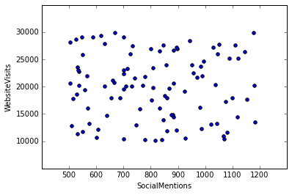
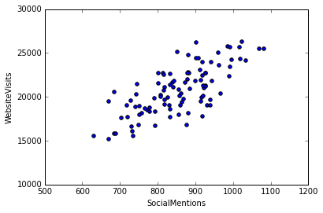
Statistical forecasting key concepts
Y-intercept
Slope
The Y-intercept is the point where the graph of a function (or, in our case, the graph of our relationship between our two variables) intersects with the y-axis.
Implication: This is the value which cannot be explained by our regression analysis, and is constant despite our measured relationship between variables. This also represents the value of our dependent variable when your independent variable is equal to zero.
The slope of the function is a number that describes both the direction and the steepness of the line graph of that function.
Implication: This tells us how much we expect our dependent variable to change with every 1-unit change in our independent variable.
Example:
Higher standard deviation and variance, correlation and r-squared values close to zero, and a zero slope
Implication:
Less predictive power
Example:
Higher standard deviation and variance, correlation and r-squared values close to zero, and a zero slope
Implication:
Less predictive power

Slide 7
Forecasting using linear regression – Our example
Linear regression
Our example will be simple and explore the use of regression analysis to predict visits to a website based on the number of social media mentions of the site.
It is reasonable to think that, as mentions of a website on social media increase, the number of people who visit the site will increase and result in increased web traffic (e.g. page hits) to the site. Starting with a thesis like this is fundamental to regression analysis.
This statistical method can be used to determine if there is a correlative relationship between two variables – in our case the relationship between the number of social media mentions (the independent variable) and visits to our website (the dependent variable). We have measures of the strength of this relationship which we will discuss later. If these measures indicates a strong relationship, we can conclude that social media mentions and visits to our website are related.
A strong relationship determined via linear regression analysis does not, however, imply a causal relationship between the two variables. Said differently, it does not imply that traffic increased to our website because of social media mentions but, rather, that increased web traffic to our website tends to increase with increases in social media mentions. This is an important distinction, though causal analysis is beyond the scope of this module.

Slide 8
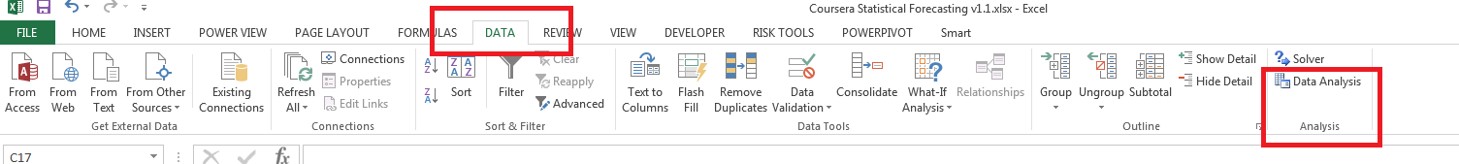
Excel Analysis ToolPak Required
ToolPak
In order to complete the exercises in this week’s problem set, you’ll need to enable the Analysis ToolPak in Excel. We’ve included a link to instructions on how to do this in the reference materials.
https://support.office.com/en-us/article/Load-the-Analysis-ToolPak-6a63e598-cd6d-42e3-9317-6b40ba1a66b4
Please take a moment to ensure that you have the ToolPak enabled before continuing. You’ll know that you’ve successfully enabled the ToolPak if you see it on the Data tab of the Ribbon, as below.

Slide 9
Additional Reference Material
Reference Material
https://en.wikipedia.org/wiki/Variance
https://en.wikipedia.org/wiki/Standard_deviation
https://en.wikipedia.org/wiki/Covariance
https://en.wikipedia.org/wiki/Correlation_and_dependence
https://en.wikipedia.org/wiki/Y-intercept
https://en.wikipedia.org/wiki/Histogram
https://support.office.com/en-us/article/Statistical-functions-reference-624dac86-a375-4435-bc25-76d659719ffd

